Slide 1

Period End Closing Key Process Areas and New Period End Checks
Branded WBS Settlement
Above Brand Contribution (ABC)
WBS Settlement / Allocation
Multi-brand WBS Settlement / Allocation
Cost Management Closing Activities
Cost Center Distribution and Assessment
Internal Order Settlement (Leaf entities only)

Slide 2
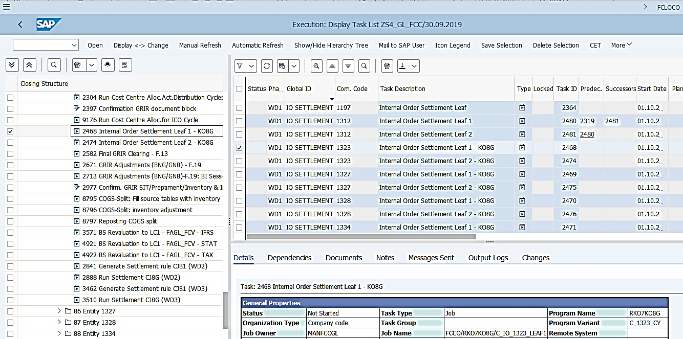
Internal Order Settlement
Basic Process of Internal Order process
In S/4HANA, Internal Orders are only used in Leaf Production process.
Costs recorded in Internal Orders
Internal Order Settlement
There are two main types of Leaf Internal Orders, LCYO (Leaf Crop Year Order) and LDIO (Leaf Dummy Order).
LCYO orders collects costs during the month, which include costs such as goods issue, billing, depreciations, accruals, as well as allocated costs from cost centers and other internal orders.
LCYO orders are settled first during the period end and LDIOs are settled afterwards.
LYCO are settled to LDIOs and LDIOs are settled partly to Business Process and partly to LYCO based on settlement rules maintained by entities.
T-Code: KO8G
In S/4 HANA, with the introduction of WBS for Cost Management purpose, Internal Orders are only used for Leaf entities in the Leaf Production process. The way how Leaf Internal Orders are set up and the settlement process has not changed from ECC to S/4 HANA.
FCC Task: Entity Level
Internal Order settlement tasks in FCC have remained at entity level with the same sequence and variants as used in ECC. Entities are in charge of determining the orders included in each variants.
Timing: WD1
On WD1 leaf Internal Orders receive some costs from Cost Center allocations and subsequently settle some of their costs to Business Processes.

Slide 3
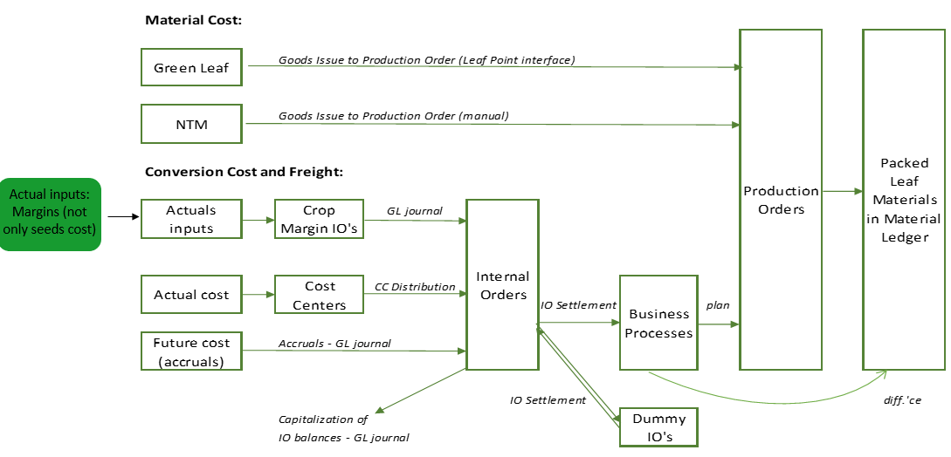
IO Settlement Rules
For any point of time, IO shows total cost of crop year. If the crop processing period is 4 months (for example), by the end of 1st month 25% of IO costs should be settled to business processes (percentage is calculated outside of the system based on production volume), leaving only residual amount of costs on the IO balance. So, IO will settle the amount related with production volume in a certain period Dummy IO is settled with residual 75% of costs for closing purposes (Month end) and afterwards costs are brought back to main cost controlling object – main IO. For new crop, IO Variant for IO Settlement is created and communicated to JTBC. Distribution Cycles for new orders should be updated. As soon as postings for old crop are finalized (usually, one month after the end of the crop), IO should be closed to prevent conversion costs of the new crop to be booked to old Internal Order (New IO for new CY to be created). Latest settlement rules for CY orders should be updated taking into consideration actual and plan volumes. After settlement is done (KO8G) and subsequently ML is closed, all variances are allocated to materials and thus Business Processes should not hold any costs.
Example representing settlement % calculation
Steps | 1st month | 2nd month | 3rd month | 4th month
Production Volume (kg) | 25 | 25 | 25 | 25
Remaining CY volume beginning of the month (kg) | 100 | 75 | 50 | 25
IO FCA (USD) | 200 000
Cost allocation based on volume | 25% | 33% | 50% | 100%
Cost allocation to BP | 25% | 33% | 50% | 100%
Cost allocation to Dummy IO | 75% | 67% | 50% | -
Cost allocation to BP (USD) | 50 000 | 50 000 | 50 000 | 50 000
Cost allocation to Dummy IO (USD) | 150 000 | 100 000 | 50 000 | -

Slide 4
Crop Year Internal Order Settlement Rules
Settlement Rules
Crop year and dummy internal orders are settled on a monthly basis irrespective of production, i.e. settlement rule needs to be updated in all months. In months without production, 100% of crop year internal orders cost is settled to respective dummy internal orders and back to crop year internal orders. In the months of production, the portion of overheads, which belongs to current month production, should be settled to business processes, and the remaining portion should be transferred to dummy internal orders and back to crop year internal orders. Percentage to be settled to business processes should be calculated based on the latest approved forecast for the crop: Settlement to Business Process % = SG Prod. Volume Month / (SG Prod. Volume Month + Remain. Crop End), SG Prod. Volume Month – lamina volume produced for the month SG Prod. Volume Month + Remain. Crop End – lamina volume produced for the month plus remaining to be produced till the end of the crop Normally, settlement percentage to business processes would increase as the crop progresses. In the last month of the crop, 100% cost would be settled to business processes.
Settlement rules created during Internal Order creation using Transaction Code KO01 (KO02 to change Internal Order)

Slide 5
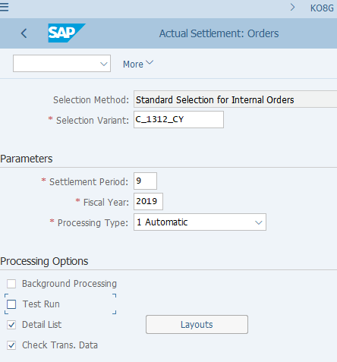
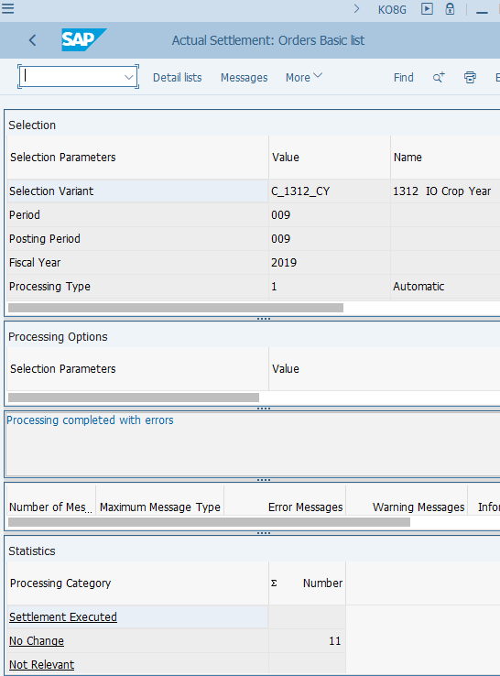
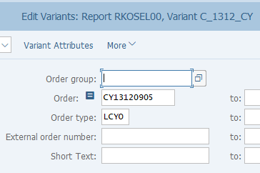
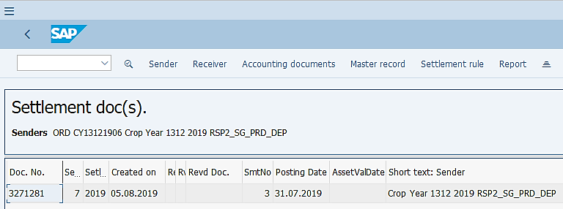
Internal Order Settlement: Execution
KO8G: Internal Order Settlement
KO8G log
Internal Order settlement variants also use “Selection Variant” like CJB1/CJ8G, but there’s no standard or custom variables used. Therefore you only need to validate if the Orders included in the Selection variants are the correct ones to be settled – you may need to confirm this with the entities.
Internal Order Settlement (KO8G) :
If you execute KO8G outside of FCC you should make sure you use the same Selection Variant as shown in the variants of the corresponding FCC task. It is possible that you may need to modify it temporarily if some ad hoc change is required. (Use the change icon for the selection variant to do so.)
It is recommended you perform a test run first so that you can act on the messages if there’s any, before you proceed with an update run.
When you perform an update run, tick Detailed List, which will show you which Internal Orders can be settled along with their senders/receivers and Accounting Documents posted.

Slide 6
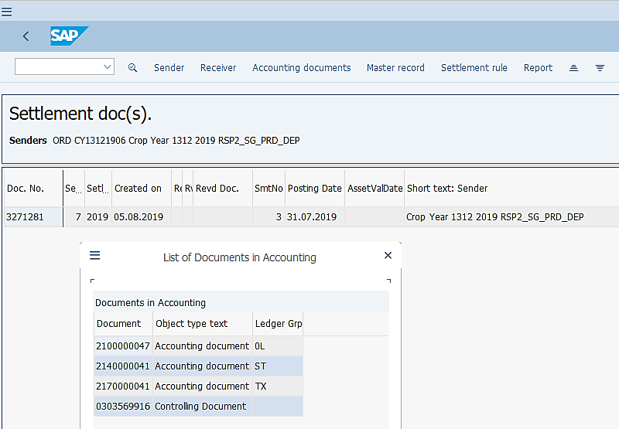
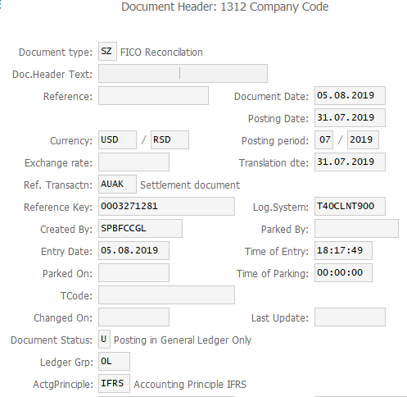
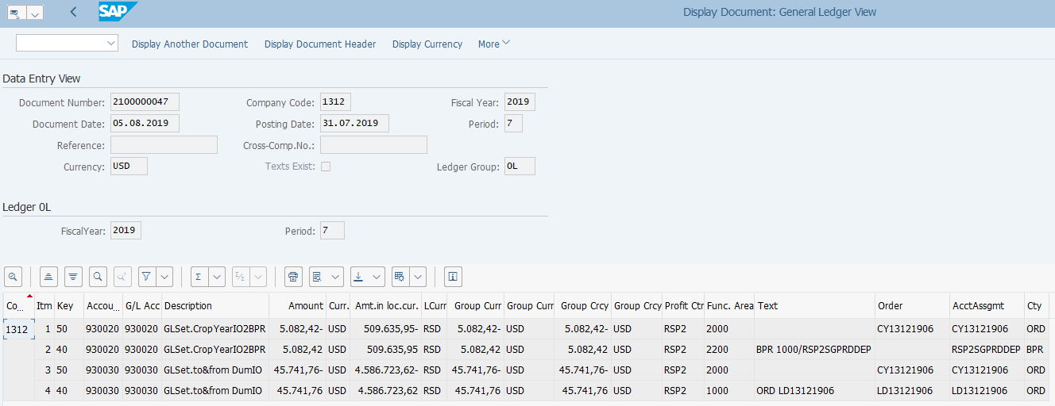
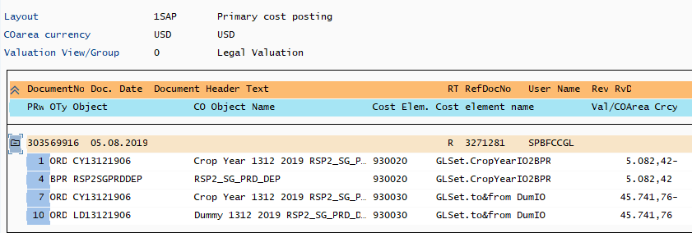
Internal Order Settlement: Postings
KO8G log – Detailed List
Internal Order Settlement (KO8G) Postings :
Depending on the ledger(s) where the costs of sender internal orders are posted, the settlement will be posted to the corresponding ledger(s).
Like Cost Center Allocations, IO settlement documents are also posted with Doc Type SZ.
At G/L line item level you can identify the movement of the costs (from/to) based on Text, Order, Account Assignment /Account Assignment Category fields.
FB03 – Display FI Documents
The Controlling Document clearly shows the sender and receiver of the settlement.

Slide 7
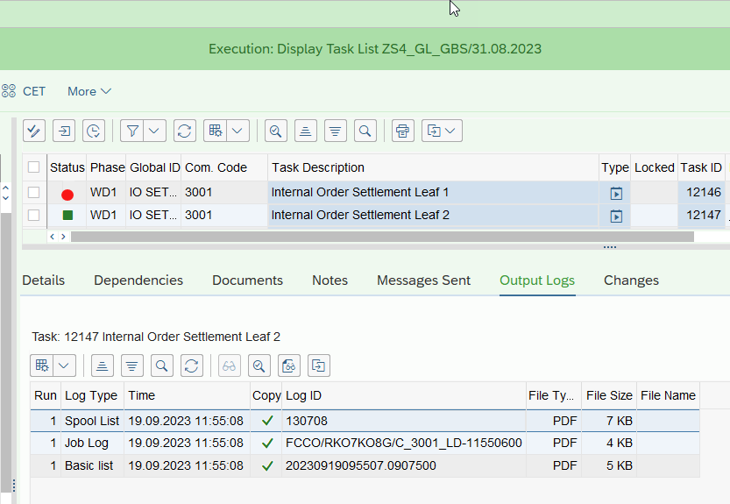
Internal Order Settlement Leaf – Common Errors
If the FCC task returns with an error status, you may check the details of the errors also on the “Output Logs” tab, by displaying the Spool List and Job Log. Usually the Spool List will explain what the errors are.
The below common errors and solutions are not specific for KO8G FCC execution, but also when you manually execute KO8G.
KO8G Transaction Common Errors | Error Reason | Error Resolution
Maintain settlement rule of the sender | Missing settlement rules | Contact Market if this error occurs and confirm the status

